Slide 1

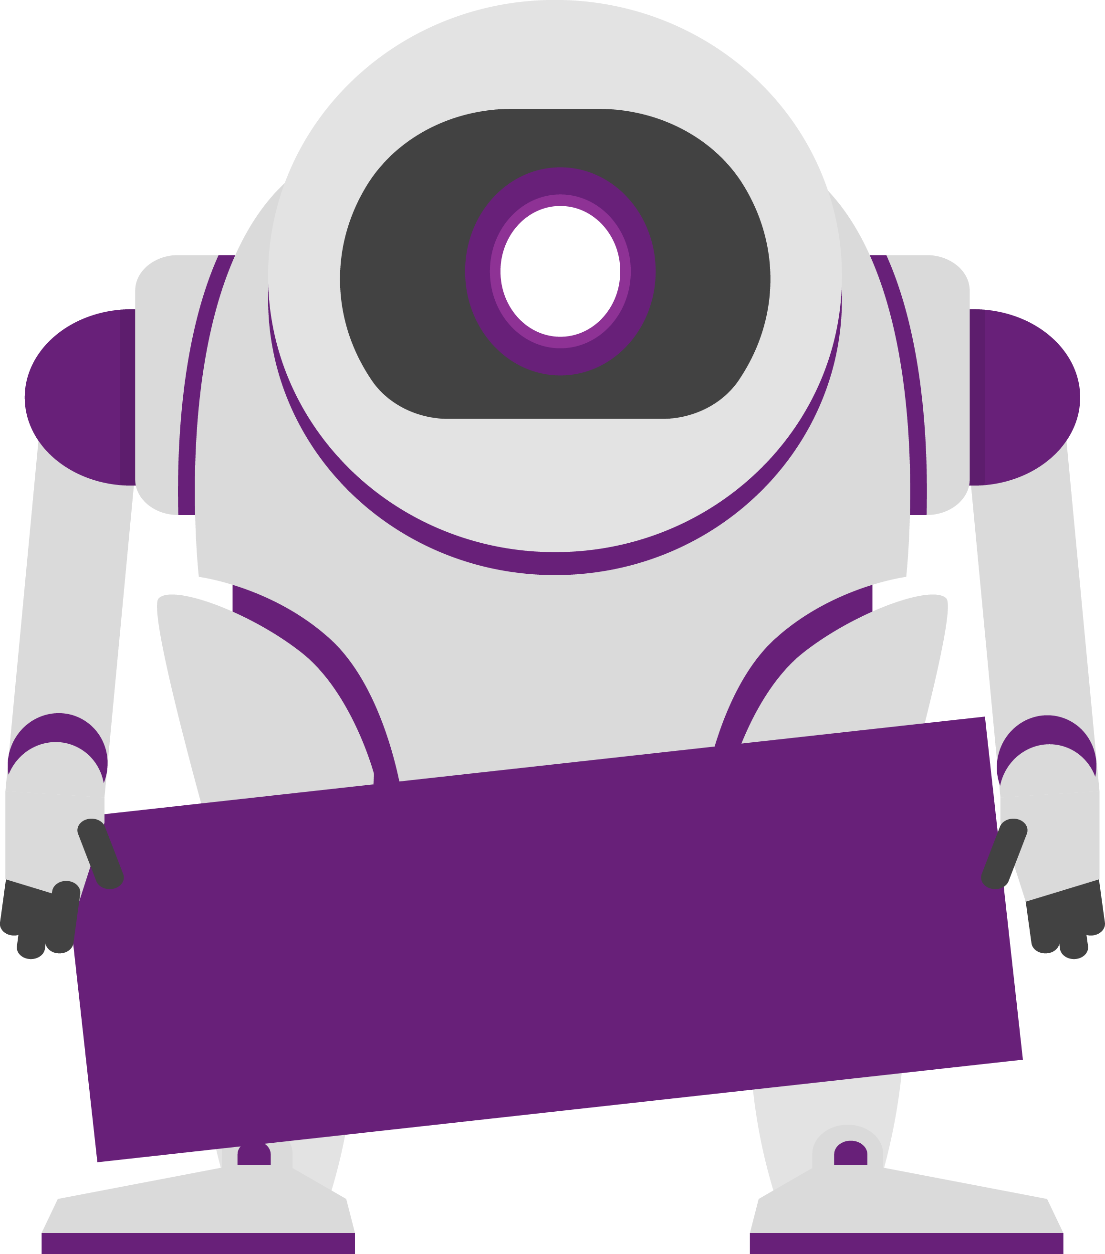
2020
Netcoreconf
Dapr: Run Microservices in Azure without SDKs or vendor lock-in
Carlos Mendible
Azure Evangelist @everis
Azure & Developer Technologies MVP
04/04/2020
@cmendibl3

Slide 2
Sponsors

Slide 3
GOALS
Understand What is Dapr
Understand how Dapr works
Understand some basic Dapr samples
Original presentation: https://github.com/dapr/docs/tree/master/presentations
Notes:
QUE QUIERO QUE CONSIGAMOS HOY?

Slide 4
State of Enterprise Developers
Being asked to develop resilient, scalable, microservice-based apps that interact with services
Increasingly polyglot. Write in many languages.
They want to leverage existing code
Functions, workflows and actors are powerful programming models

Slide 5
What is holding microservice development back?
Hard to incrementally migrate from existing code to a microservices architecture
Programming model runtimes have narrow language support and tightly controlled feature sets
Runtimes only target specific infrastructure platforms with limited code portability across clouds and edge

Slide 6
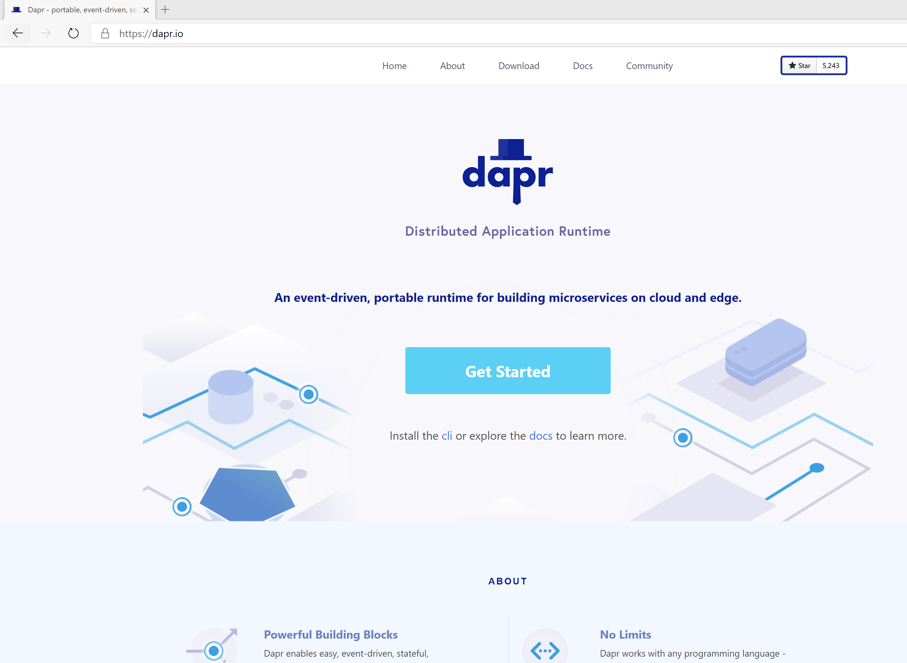

Distributed Application Runtime
Portable, event-driven, runtime for building distributed applications across cloud and edge
https://dapr.io

Slide 7
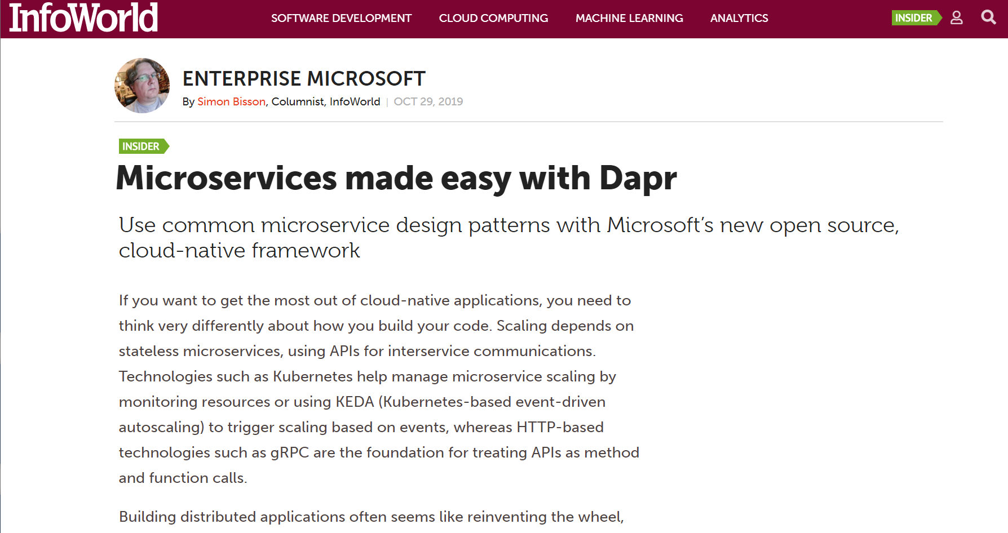
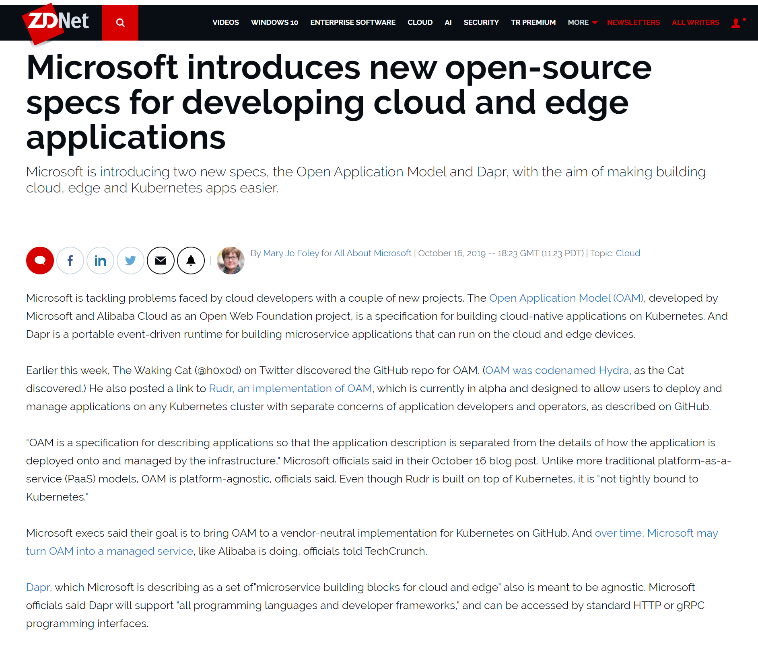
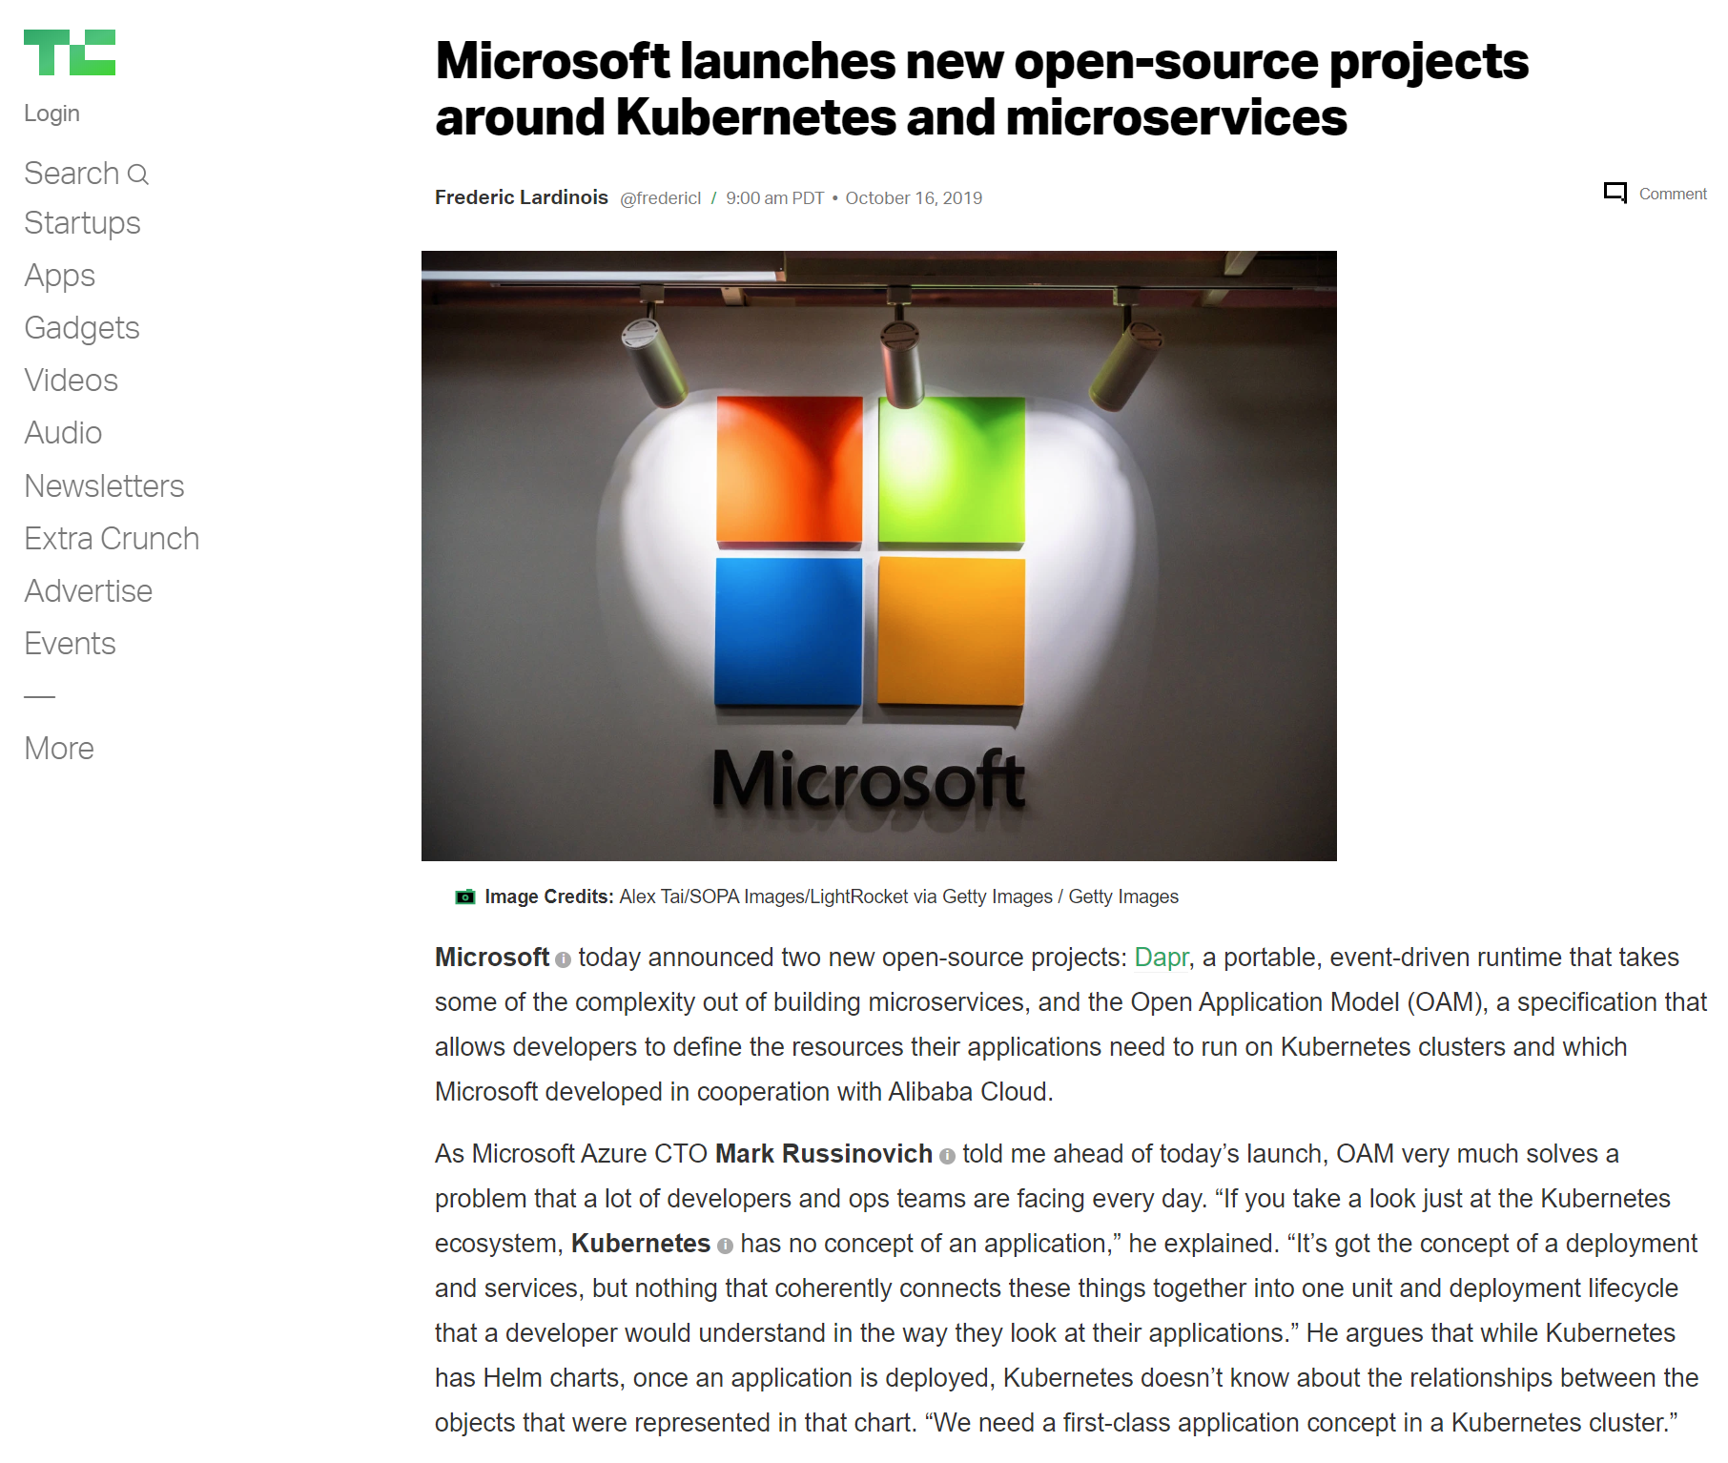
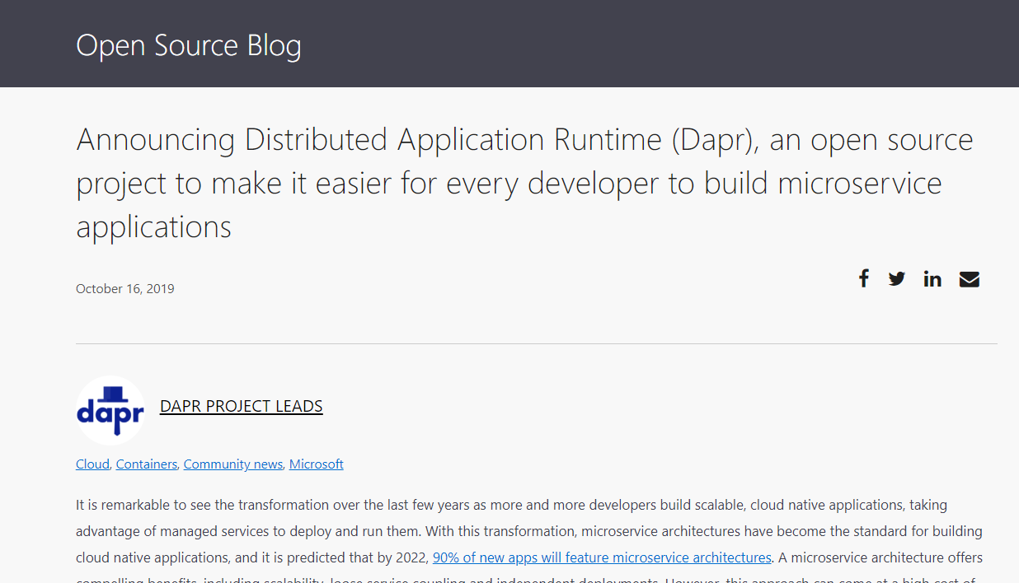

Slide 8

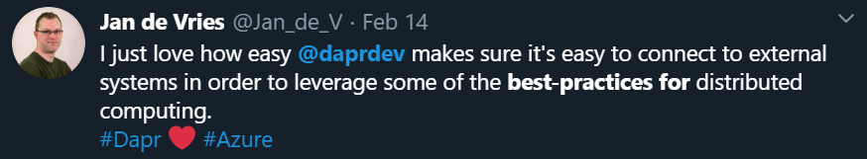
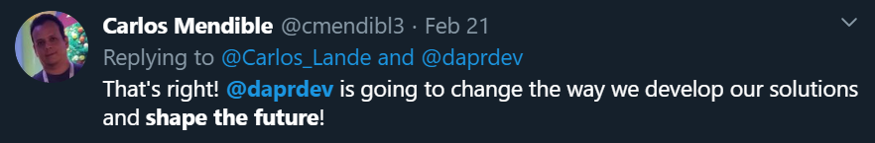

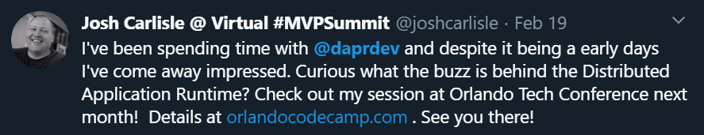
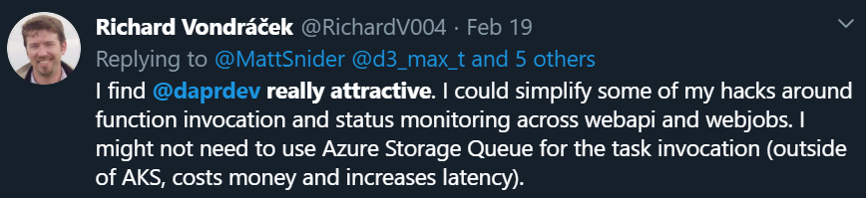
https://github.com/dapr/dapr#community
54 External Contributors
28 new components added since launch
5.7k GitHub stars in under 5 months
Community call every 2 weeks

Slide 9
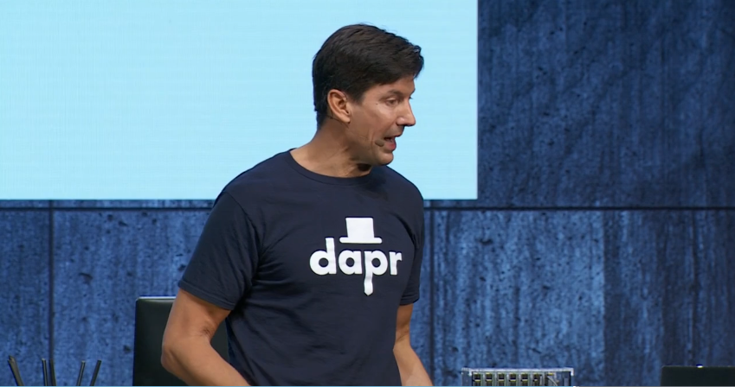
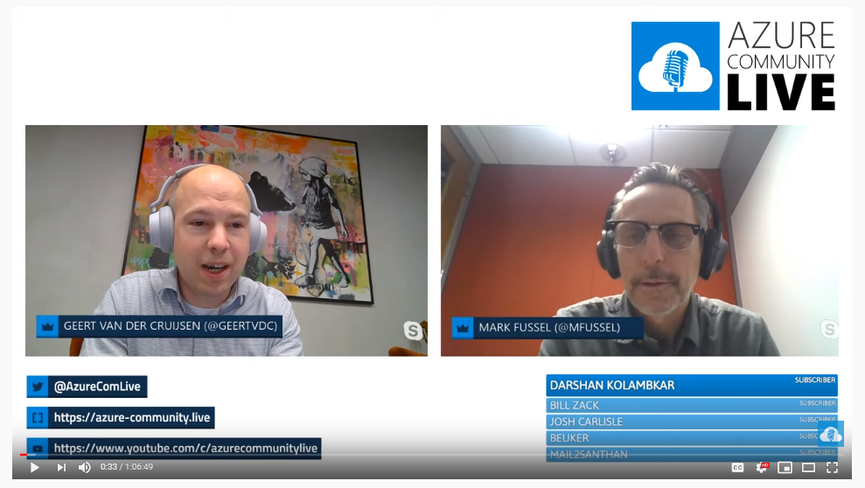
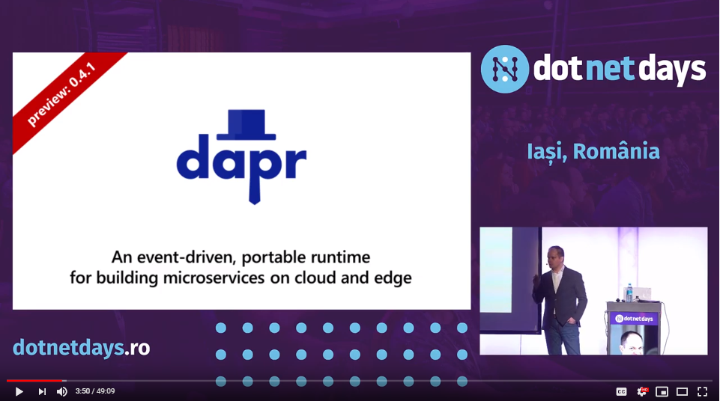
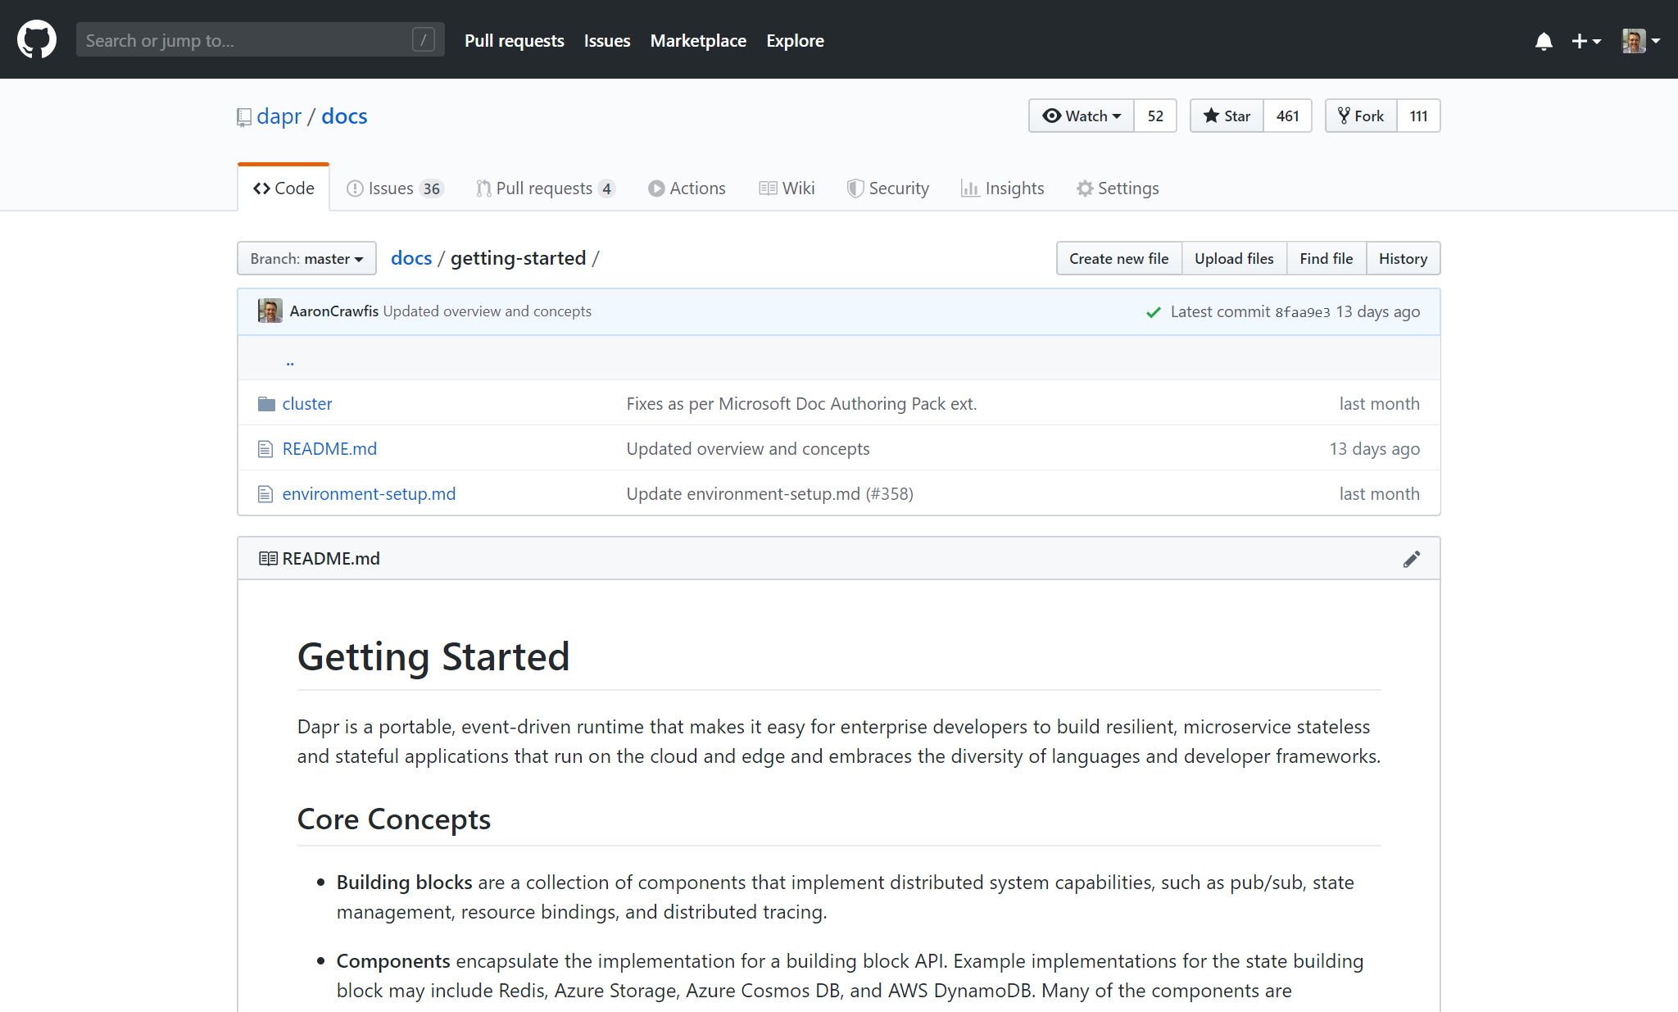
Where to Learn Dapr?
https://github.com/dapr/dapr#community

Slide 10








Dapr Goals
Best-Practices
Building Blocks
Any Language
or Framework
Community Driven
Vendor Neutral
Adopt Standards
Consistent, Portable,
Open APIs
Platform Agnostic
Cloud + Edge
Extensible and
Pluggable Components

Slide 11
Application Types
Develop resilient, scalable, microservice-based apps that interact with services
stateless, stateful, long-running, short-lived function-like
Increasingly apps are polyglot. Written with different languages and frameworks

Slide 12

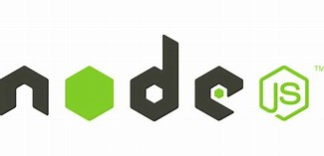



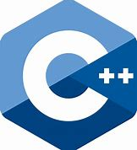
Microservice building blocks
Standard APIs accessed over http/gRPC protocols from user service code http://localhost:3500/v1.0/state/inventory/orderkey
http://localhost:3500/v1.0/invoke/myapp/method/neworder
Runs as local “side car library” dynamically loaded at runtime for each service
Application code
Microservice building blocks
Microservices written in
Any code or framework…
HTTP API
gRPC API
Service-to- service invocation
State management
Publish and subscribe
Resource bindings and triggers
Actors
Distributed tracing
Secrets
Extensible

Slide 13

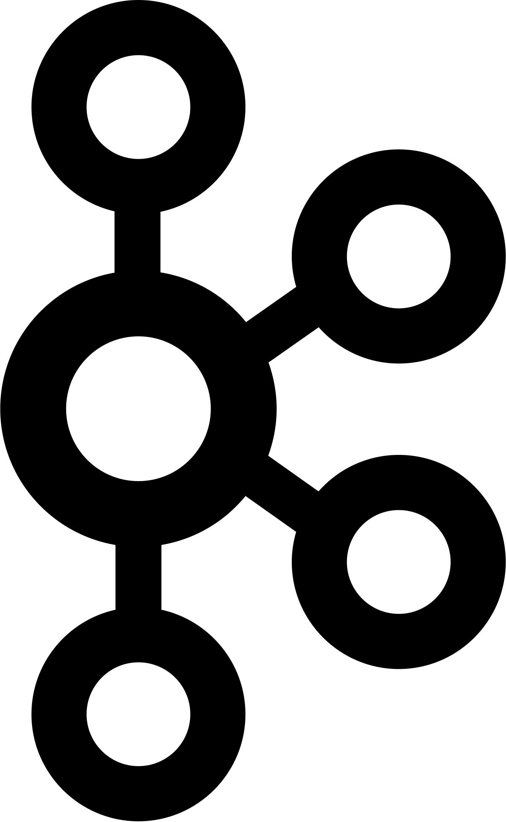






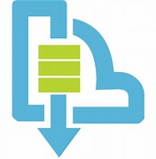
Sidecar and component architecture
Resource bindings
…others
Scanning for events
Input/output
EventHub
Kafka
AWS SQS
GCP pub/sub
Application
Secure communication with mTLS
Service
code A
Service
code B
Dapr API
Dapr API
Tracing, logs
and metrics
Tracing, logs
and metrics
Sidecar
Sidecar
Load and
save state
State stores
…others
AWS DynamoDB
CosmosDB
Publish & subscribe
Messaging
…others
Service Bus

Slide 14
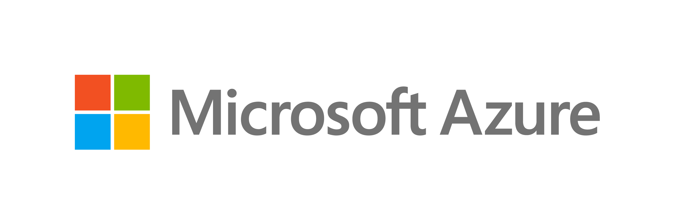

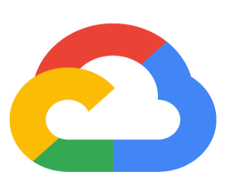




Dapr: Distributed Application Runtime Build apps using any language with any framework
Application code
Microservices written in
Any code or framework…
HTTP API
gRPC API
Service-to- service invocation
State management
Publish and subscribe
Resource bindings and triggers
Actors
Distributed tracing
Secrets
Extensible
Any cloud or edge infrastructure

Slide 15




Dapr Kubernetes hosted
Deploys and manages Dapr
1
Components
Updates actor partition placement
Certificate Authority
Update component changes
Resource bindings
Pod
Pod
Pod
Pod
Input/output
CONTAINER
CONTAINER
CONTAINER
CONTAINER
…others
Component management
EventHub
Kafka
AWS SQS
GCP pub/sub
Actor Placement
Sidecar Injector
Sentry
Operator
State stores
Injects Dapr runtime
AWS
DynamoDB
CosmosDB
…others
Pod
CONTAINER
Dapr API
CONTAINER
Publish & subscribe
HTTP or gRPC
…others
Sidecar
Application code
Service Bus
Distributed Tracing
Uses components
Any cloud or edge infrastructure
Prometheus
AppInsightts
Jaeger

Slide 16
Common questions?
Is Dapr a service mesh?
Does Dapr work with autoscalers like KEDA?
Does Dapr work with reverse proxy servers like NGINX, Traefik?

Slide 17


Dapr, KEDA and Linkerd
1
Pod
Pod
Pod
CONTAINER
CONTAINER
dapr API
HTTP or gRPC
Application code
External trigger resource
CONTAINER
Scale pods
Pod
Horizonal pod autoscaler
CONTAINER

Slide 18
Microservice building blocks
Service-to- service invocation
State management
Publish and subscribe
Resource bindings and triggers
Actors
Distributed tracing
Secrets
Perform direct, secure, service-to-service method calls
Create long running, stateless and stateful services
Secure, scalable messaging between services
Trigger code through events from a large array of inputs
Output bindings to external resources including databases and queues
Encapsulate code and data in reusable actor objects as a common microservices design pattern
See and measure the message calls across components and networked services
Securely access secrets from your application
Use Dapr components

Slide 19
Microservice building blocks
Service invocation
Post
http://localhost:3500/v1.0/invoke/cart/method/checkout
{
"user":"johndoe",
"cart":"0001"
}
“frontend”
Post
http://10.0.0.2:8000/checkout
{
"user":"johndoe",
"cart":"0001"
}
“cart”

Slide 20
Microservice building blocks
State management: key/value
Get
http://localhost:3500/v1.0/state/<store-name>/planet
{
"name": "Tatooine"
}
App
“myApp”
key | value
myApp-weapon | "DeathStar"
myApp-planet | { "name": "Tatooine" }
Post
http://localhost:3500/v1.0/state/<store-name>
[{
"key": "weapon",
"value": "DeathStar"
}, {
"key": "planet",
"value": {
"name": "Tatooine"
}
}]
State store of your choice
AWS
DynamoDB
CosmosDB
…others

Slide 21
DEMO: Dapr state management and bindings
DEMO
Dapr state management
and components

Slide 22
Microservice building blocks
Publish and subscribe
Publish
Subscribe
“cart”
“shipping”
Post
http://10.0.0.5:8005/order
Post
http://localhost:3500/v1.0/publish/
"data":{
"user":"johndoe",
"item":"ZeroDay"
}
"topic":"order",
"data":{
"user":"johndoe",
"item":"ZeroDay"
},
Post
http://10.0.0.4:8004/order
“email”

Slide 23
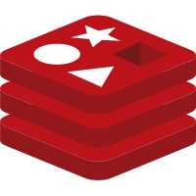

Microservice building blocks
Resource triggers: Input
Get / Post
http://localhost:8000/trigger
Redis
{
"user":"johndoe"
}
App
Event Hubs
Redis
SQS
Event Hubs
Kafka
Kafka
SQS

Slide 24

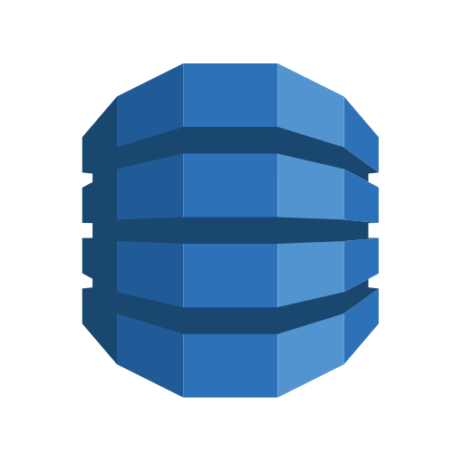

Microservice building blocks
Resource bindings: Output
Redis
Event Hubs
App
“myApp”
DynamoDB
Redis
Event Hubs
CosmosDB
Kafka
Twilio
DynamoDB
Post
http://localhost:3500/v1.0/bindings/myDatabase
CosmosDB
{
"data":
{
"sku":"v100",
"quantity":"50"
}
}
Kafka
Twilio

Slide 25




App Insights
Azure Monitor
Microservice building blocks
Distributed tracing and diagnostics
Datadog
App
“frontend”
Instana
Jaeger
App Insights
Datadog
Instana
Jaeger
SignalFX
Prometheus
OpenCensus
+ many more
App
“backend”
SignalFX
Prometheus
+ many more

Slide 26





Cloud Secret Stores
Microservice building blocks
Secrets
Google
Key Management
Azure
Key Vault
Application
code
GET
http://localhost:3500/v1.0/secrets/vault/mysecret
mysecret “supersecret”

Slide 27
Microservice building blocks
Secrets with Azure Kubernetes Service
Azure
Key Vault
1
Pod
Application
code
GET
http://localhost:3500/v1.0/secrets/vault/mysecret
mysecret “supersecret”
Pod
Managed Identity

Slide 28
Microservice building blocks
Secrets with Kubernetes
1
Pod
Application
code
GET
http://localhost:3500/v1.0/secrets/vault/mysecret
mysecret “supersecret”
Kubernetes
Secret Store

Slide 29
DEMO
Secrets with Azure Kubernetes Service

Slide 30
Dapr language SDKs
Distributed Application Runtime Build apps using any language with any framework
Application code
Microservices written in
Any code or framework…
HTTP API
gRPC API
Service-to- service invocation
State management
Publish and subscribe
Resource bindings and triggers
Actors
Distributed tracing
Secrets
Extensible
Any cloud or edge infrastructure

Slide 31




Integration with developer frameworks
Application code
Microservices written in
Any code or framework…
Virtual
Actors
ASP.NET Core
Functions
Logic Apps
Spring Boot
Server Side
Blazor
HTTP API
gRPC API
Service-to- service invocation
State management
Publish and subscribe
Resource bindings and triggers
Actors
Distributed tracing
Secrets
Extensible
Any cloud or edge infrastructure

Slide 32
Virtual Actors with Dapr
Stateful, objects of storage and compute
Dapr Actor features:
Distribution and failover
Turn-based concurrency
State management
Timers
Reminders
Host/Pod
Video Game Enemy
X pos
Y pos
Z pos
Difficulty
Spawn( )
Host/Pod
Weapons
Attack( )
Virtually identical to Service Fabric Reliable Actors

Slide 33
Pod X
Microservice building blocks
Post
http://10.0.0.6:6004/update
Actors
Actor A
{
"speed":"1"
}
Placement service
Actor B
Get Actor location
App
Pod Y
Invoke
Actor
Actor C
Post
http://localhost:3500/v1.0/actors/MyActors/A/method/update
Actor D
{
"speed":"1"
}

Slide 34
Pod X
Microservice building blocks
Post
http://10.0.0.6:6004/update
Actors
Actor A
{
"speed":"1"
}
Placement service
Actor B
Determine actor node placement
App
Pod Y
Invoke
Actor
Allocate
Actor C
Post
http://localhost:3500/v1.0/actors/MyActors/C/method/update
Post
http://10.0.0.7:6005/update
Actor D
{
"speed":"1"
}
{
"speed":"3"
}

Slide 35
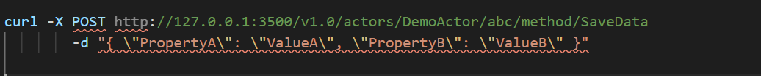
Actor Invocation
Standard actor API
http://localhost:3500/v1.0/actors/<actorType>/<actorId>/method/<method>
Invoke the GetData method on DemoActor actor with id=abc
Invoke the SaveData method on DemoActor actor with id=abc, providing values for PropertyA and PropertyB

Slide 36
DEMO
ASP.NET Core with Dapr

Slide 37
Dapr and Azure Functions
Building an Azure Functions Dapr extension
Enables an Azure Function to interact seamlessly with Dapr capabilities in Kubernetes, IoT Edge and other hosting platforms

Slide 38




Secure ingress communication
Daprize proxy servers
Ingress
App
Secure communication with mTLS
Service
code
Dapr
API
Service
code
Service
code
Dapr
API

Slide 39
Secure ingress communication
Daprize proxy servers
1
Ingress Pod
App Pod
Secure communication with mTLS
Service
code
Dapr
API
Service
code
Service
code
Dapr
API

Slide 40
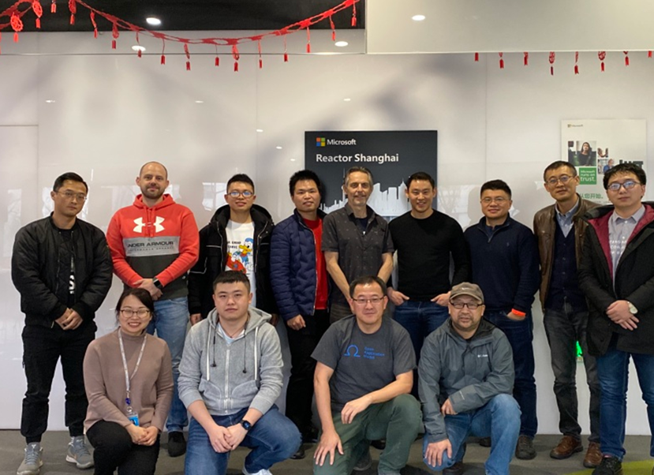
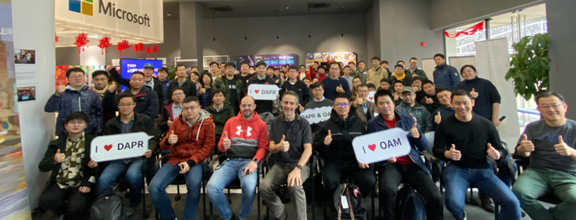
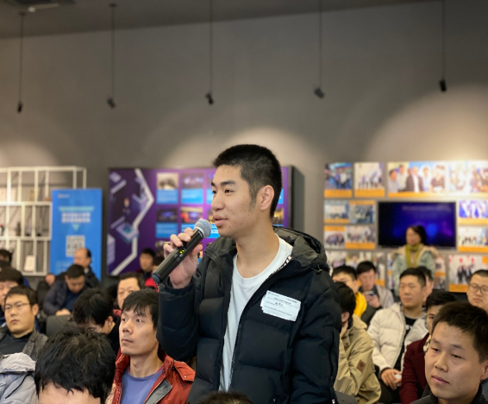
Get involved
1
https://github.com/dapr/dapr#community

Slide 41
Sponsors

Slide 42
Más información:
info@netcoreconf.com
@Netcoreconf
Visítanos en:
netcoreconf.com
GRACIAS

